Slide 1
Machine Learning Project Documentation
Prepared By: Samer Wael Elbehidy
Here is where My Documentation begins

Slide 2
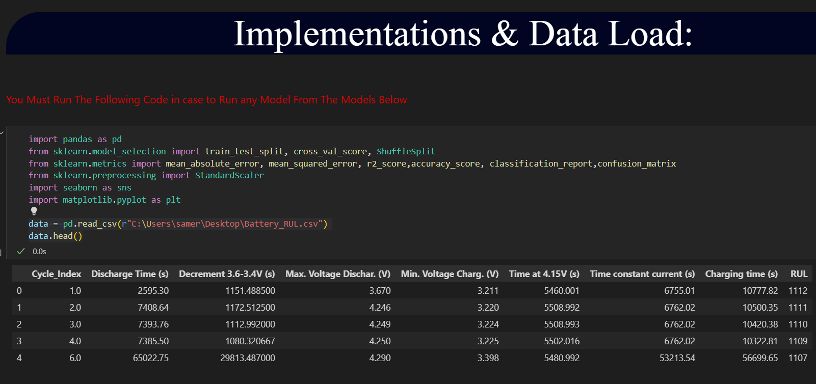

Slide 3
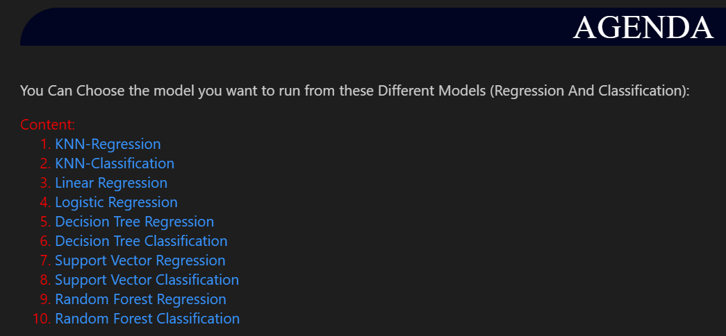
Business plan

Slide 4
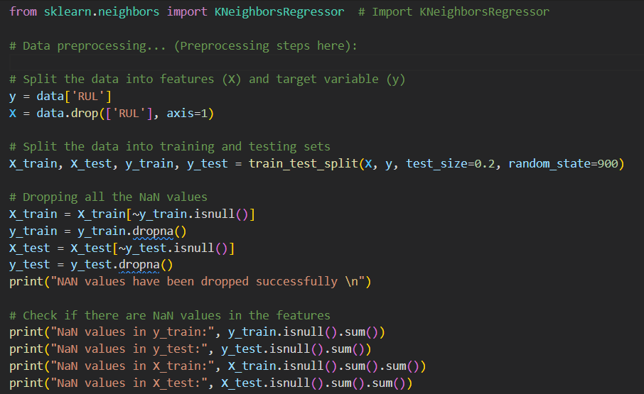
KNN Regression : K-Nearest Neighbors (KNN) Regression is a non-parametric and lazy supervised learning algorithm used for both classification and regression tasks. In KNN regression, the algorithm predicts the target variable by averaging the values of its k-nearest neighbors

Slide 5
KNN Regression :

Slide 6
KNN Regression :

Slide 7
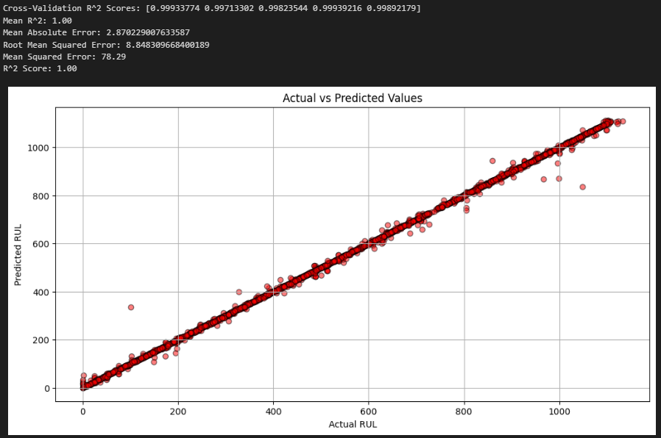
KNN Regression Results :

Slide 8
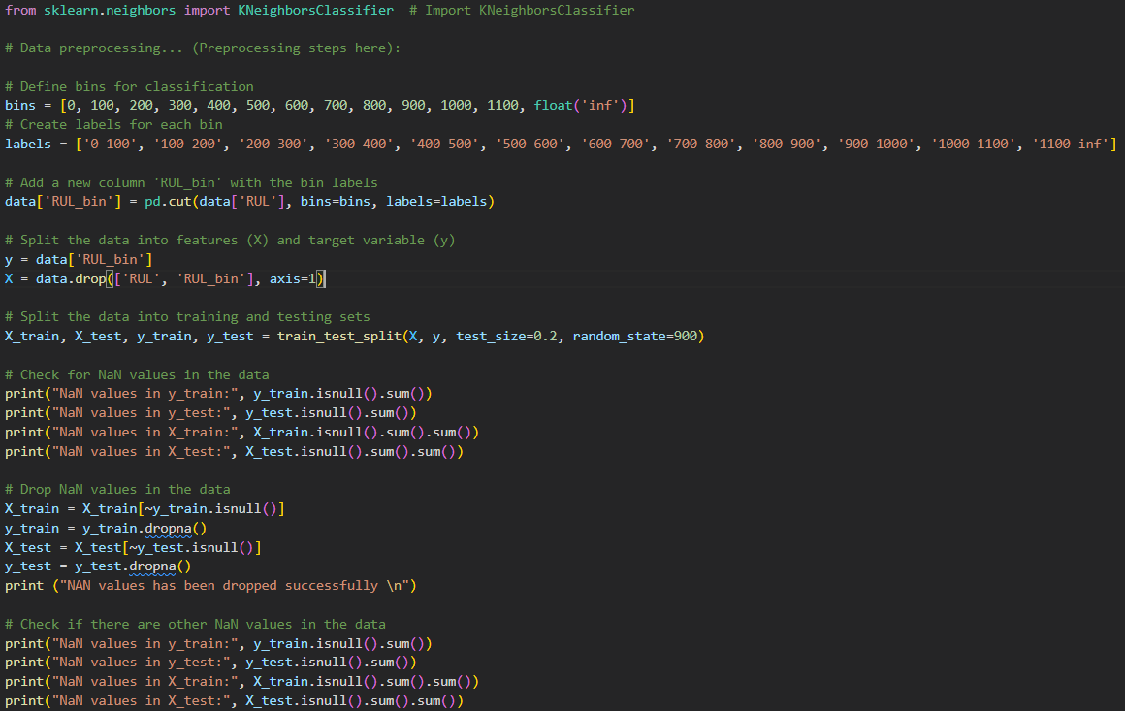
KNN Classification :
K-Nearest Neighbors (KNN) Classifier is a simple and intuitive machine learning algorithm used for classification tasks. It belongs to the family of lazy or instance-based learning algorithms.

Slide 9
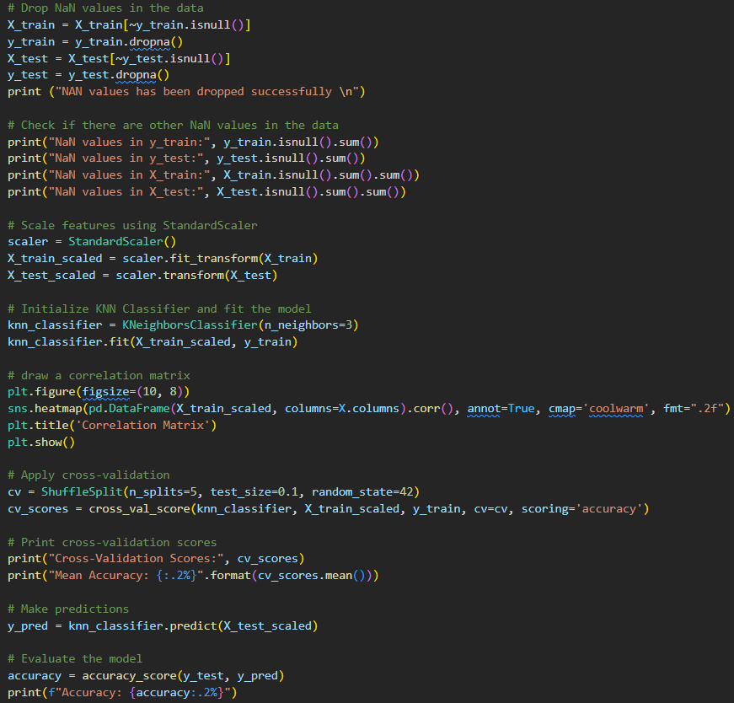
KNN Classification :

Slide 10
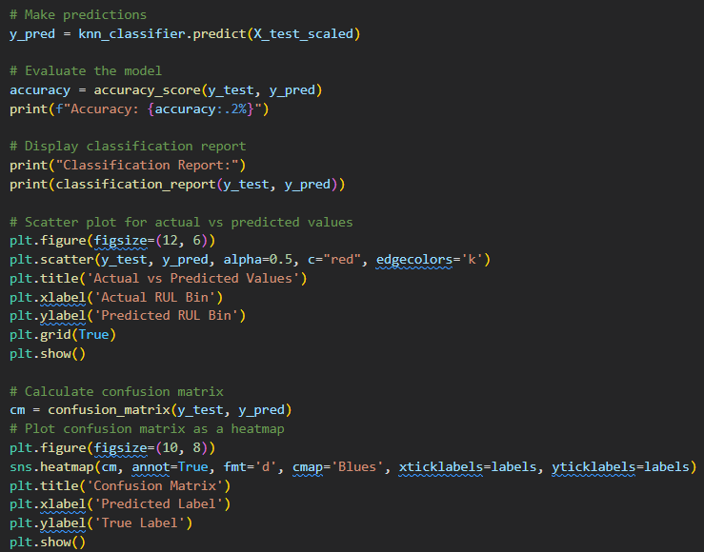
KNN Classification :

Slide 11
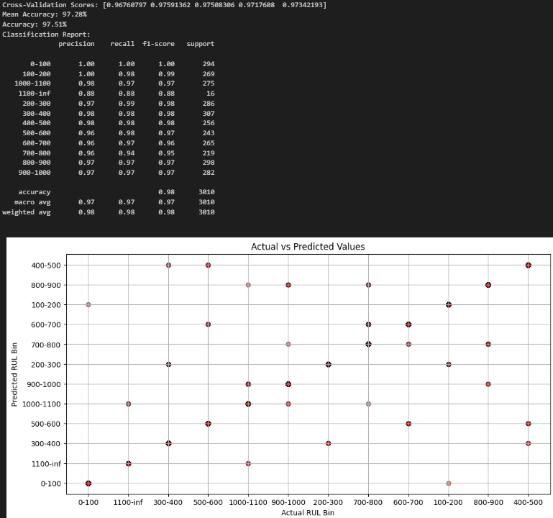
KNN Classification results:

Slide 12
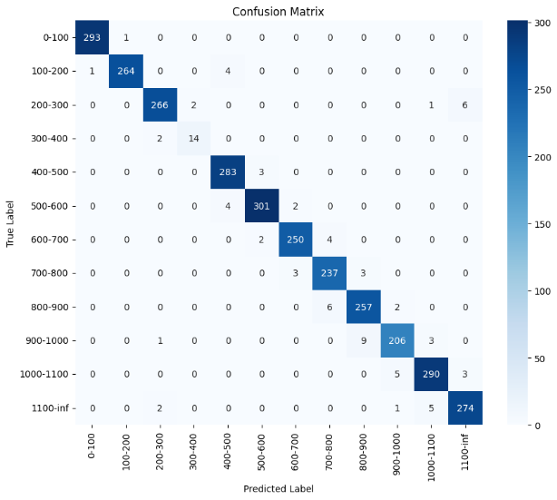
KNN Classification results:

Slide 13
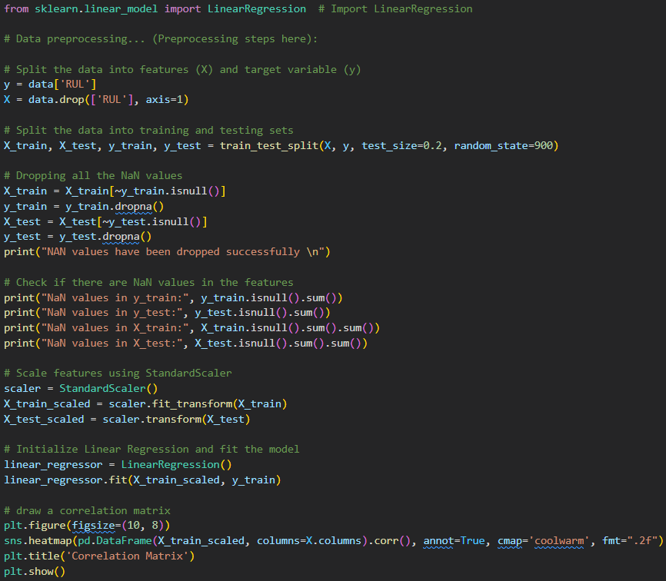
Linear Regression :
Linear Regression is a fundamental statistical and machine learning technique used for predicting a continuous target variable based on one or more predictor variables.

Slide 14
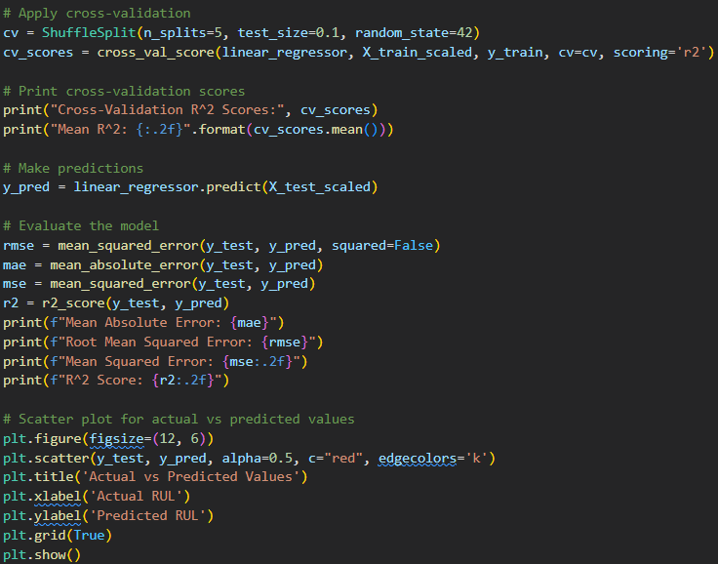
Linear Regression :

Slide 15
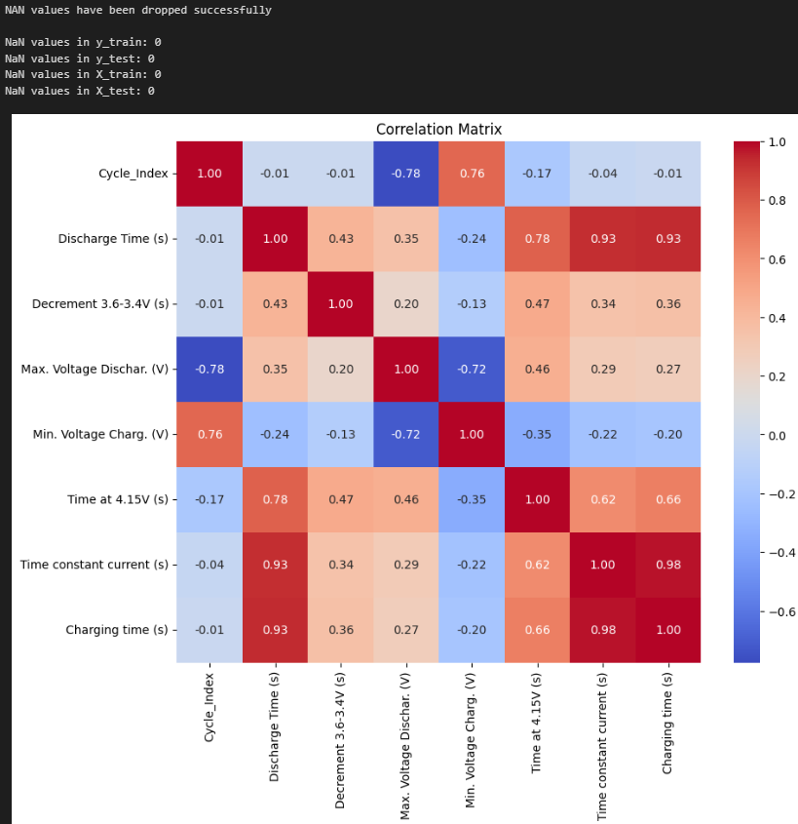
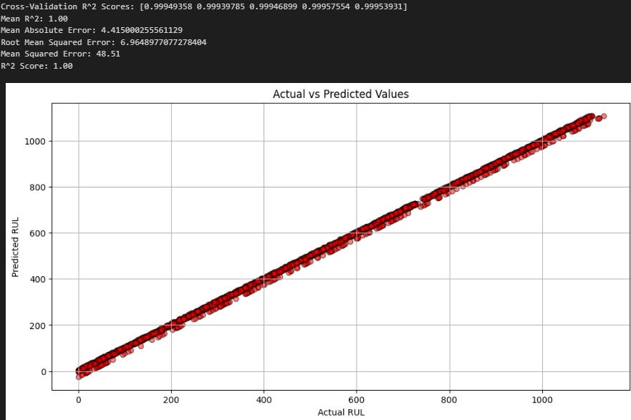
Linear Regression results:

Slide 16
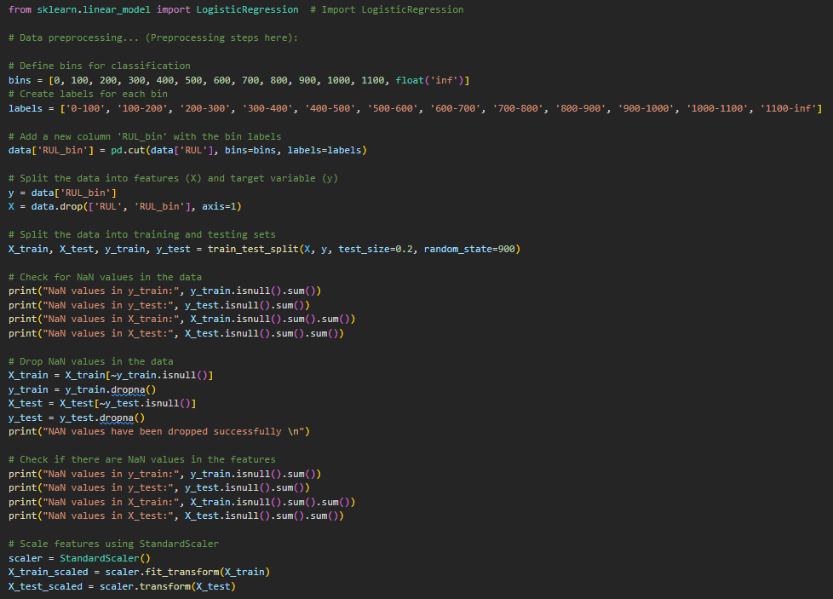
Logistic Regression :
Logistic Regression is a statistical and machine learning model used for binary and multi-class classification tasks. Despite its name, it is primarily employed for classification rather than regression.

Slide 17
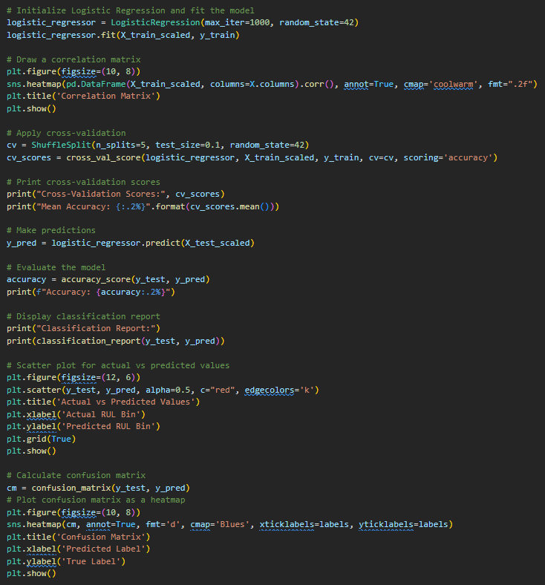
Logistic Regression :

Slide 18
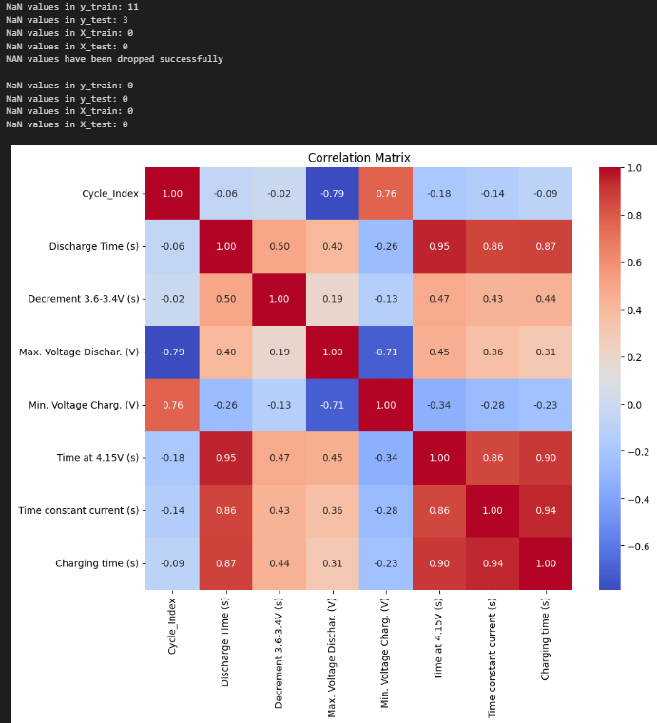
Logistic Regression results:

Slide 19
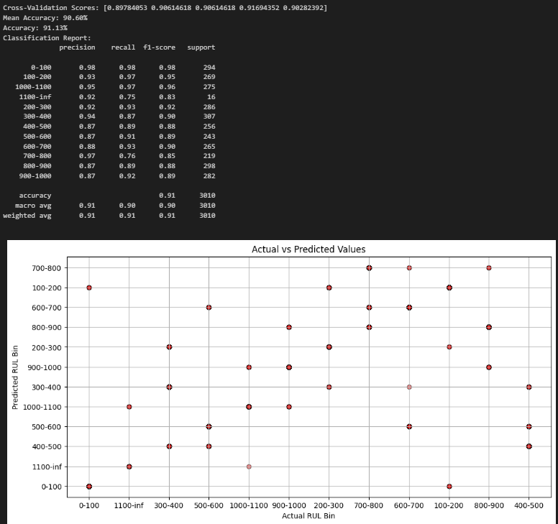
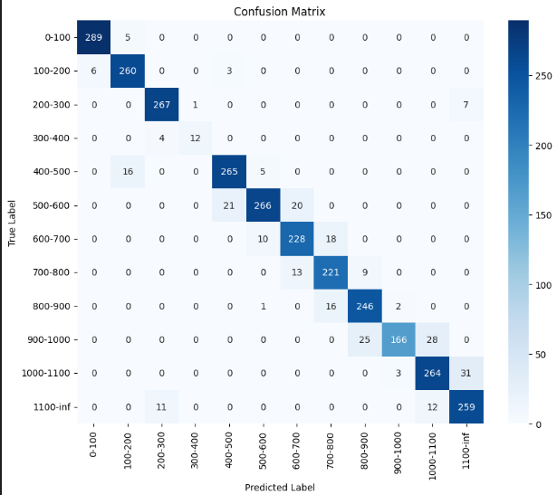
Logistic Regression results:

Slide 20
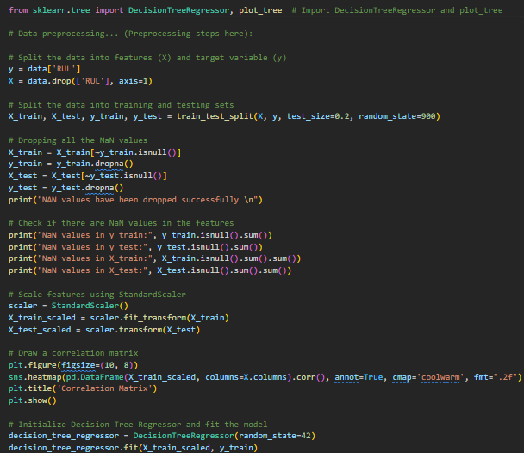
Decision Tree Regression :
Decision Tree Regression is a machine learning algorithm used for predicting continuous numerical values. Unlike its classification counterpart, decision trees for regression tasks aim to predict a real-valued output rather than a categorical one.

Slide 21
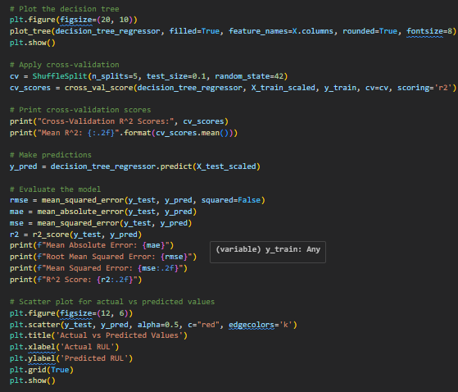
Decision Tree Regression :

Slide 22
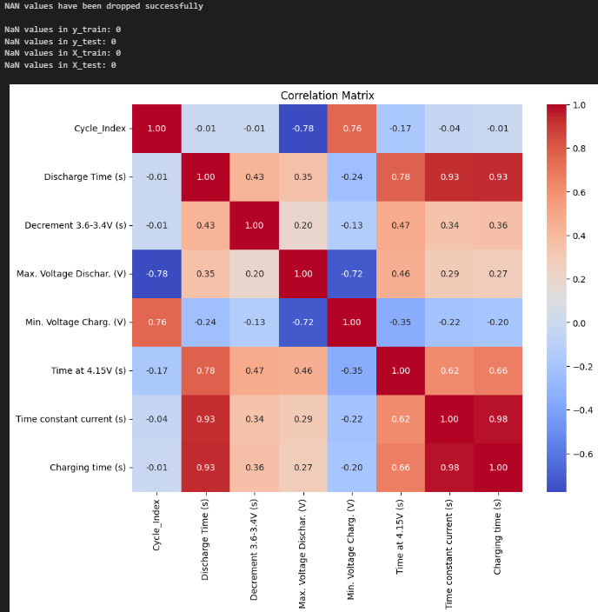
Decision Tree Regression results:

Slide 23
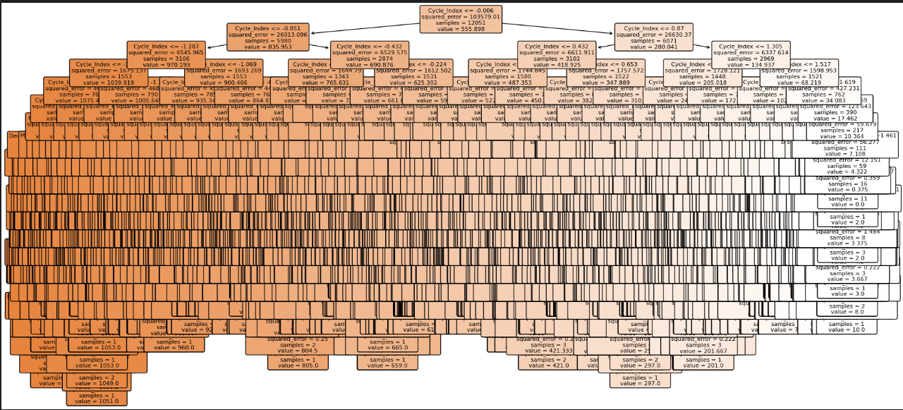
Decision Tree Regression results:

Slide 24
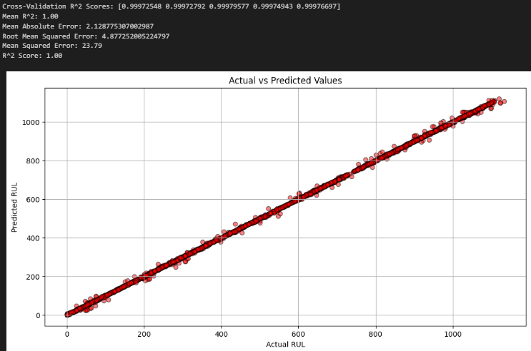
Decision Tree Regression results:

Slide 25
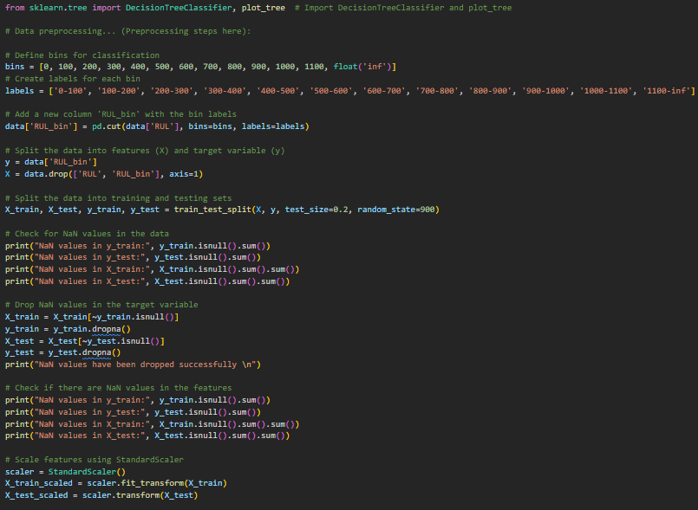
Decision Tree Classification :
Decision Tree Classification is a machine learning algorithm used for predicting categorical outcomes or class labels. It is widely employed in various domains for its simplicity and interpretability.

Slide 26
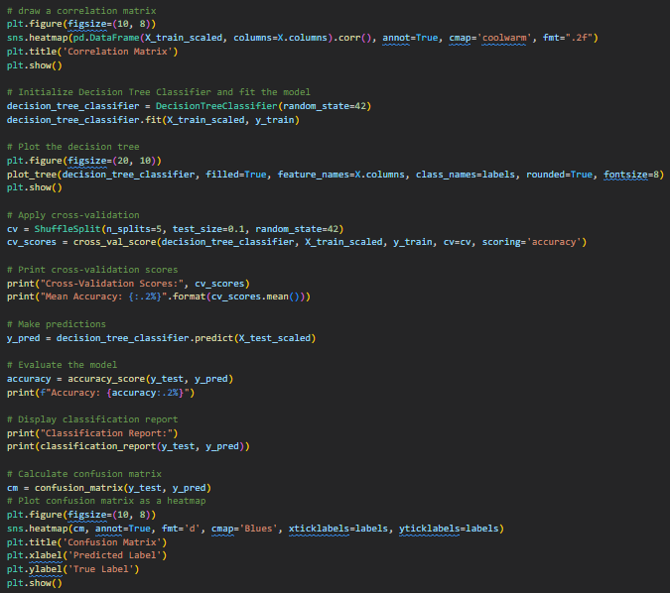
Decision Tree Classification :

Slide 27

Decision Tree Classification results:

Slide 28
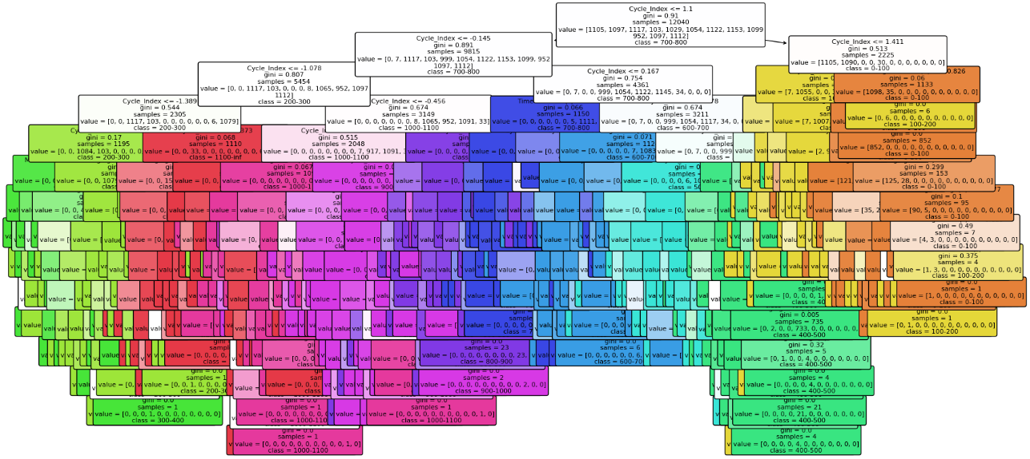
Decision Tree Classification results:

Slide 29
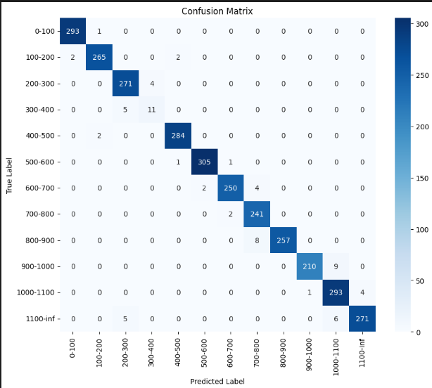
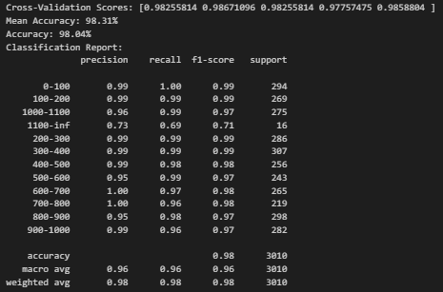
Decision Tree Classification results:

Slide 30
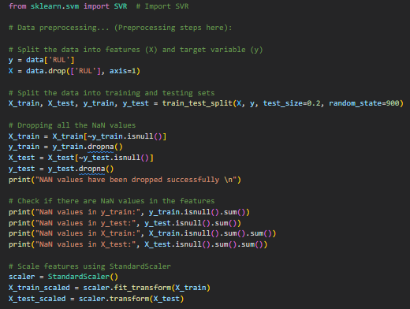
Support Vector Regression :
Support Vector Regression is a supervised machine learning algorithm used for regression tasks. It belongs to the family of Support Vector Machines (SVM) and is particularly effective in capturing complex relationships in data.

Slide 31
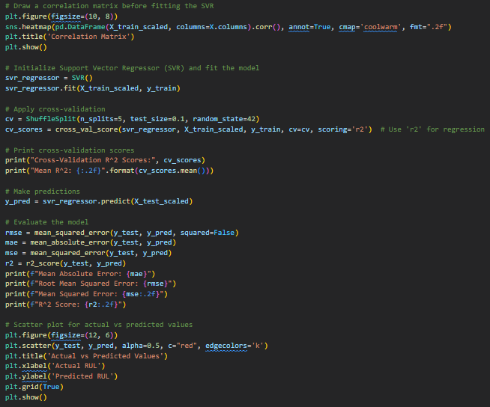
Support Vector Regression :

Slide 32
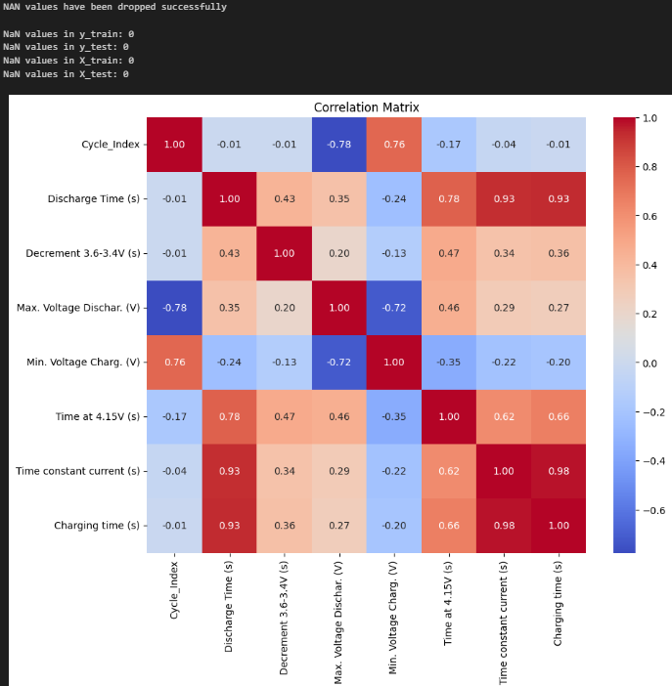
Support Vector Regression results :

Slide 33
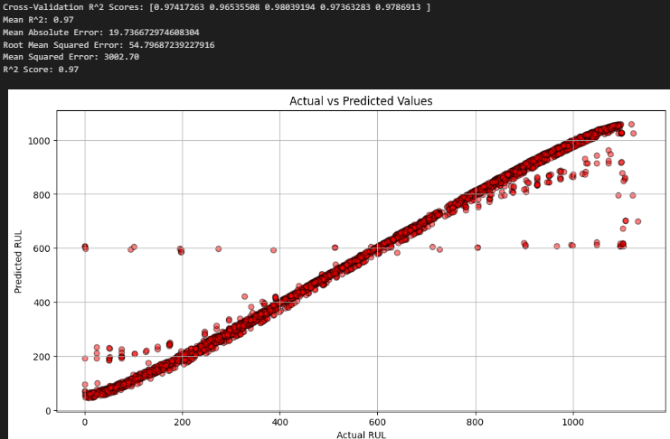
Support Vector Regression results :

Slide 34
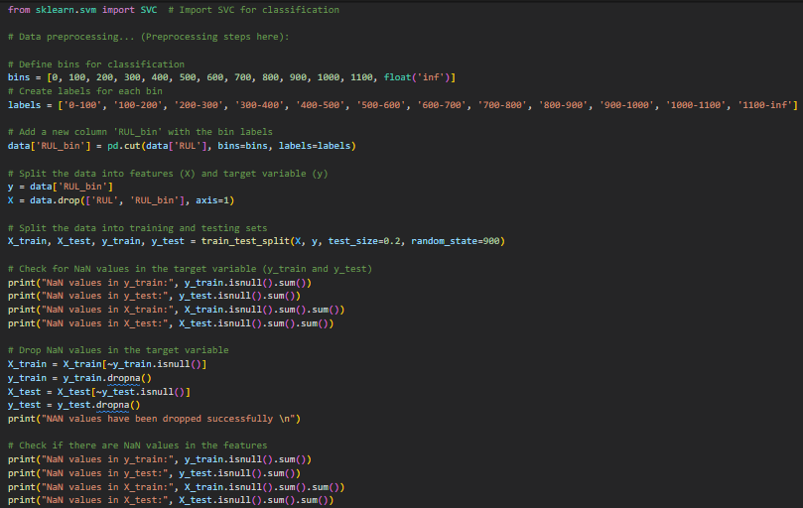
Support Vector Classification :
Support Vector Classification, commonly known as Support Vector Machine (SVM), is a powerful machine learning algorithm used for classification tasks.

Slide 35
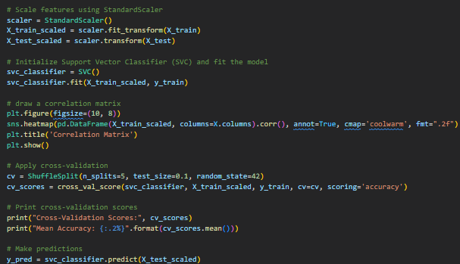
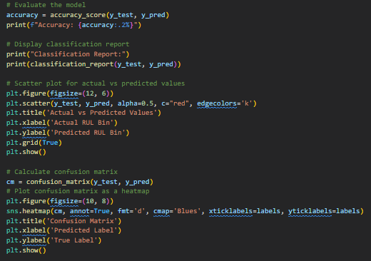
Support Vector Classification :

Slide 36

Support Vector Classification results :

Slide 37
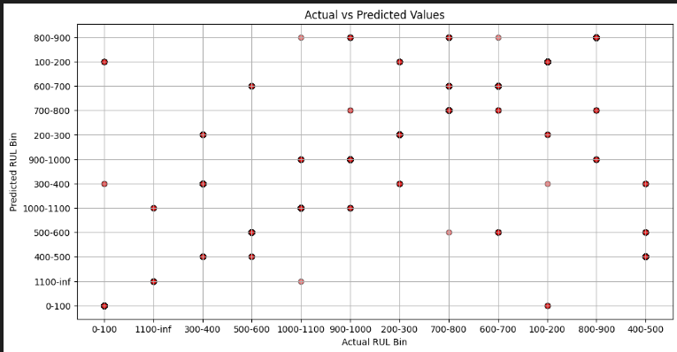
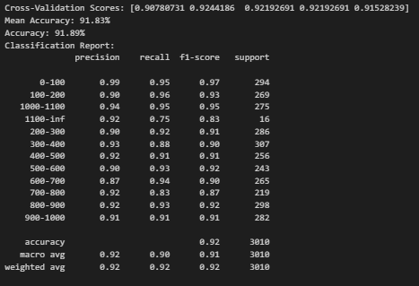
Support Vector Classification results :

Slide 38
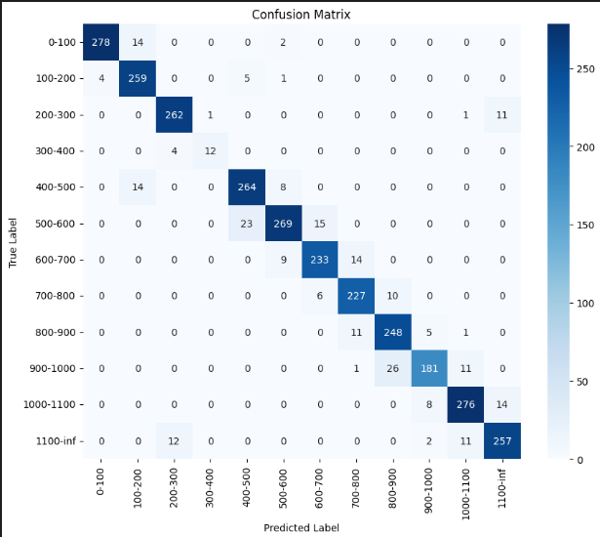
Support Vector Classification results :

Slide 39
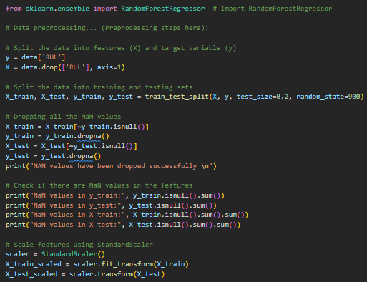
Random Forest Regression :
Random Forest Regression is an ensemble learning algorithm used for making predictions in regression tasks. It builds multiple decision trees and combines their outputs to provide a more accurate and robust prediction.

Slide 40
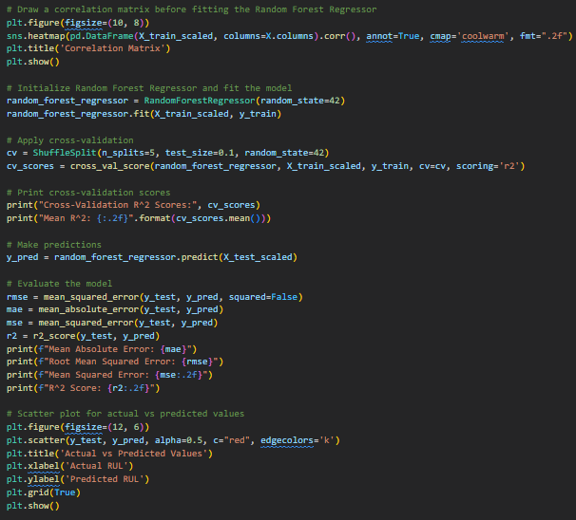
Random Forest Regression :

Slide 41
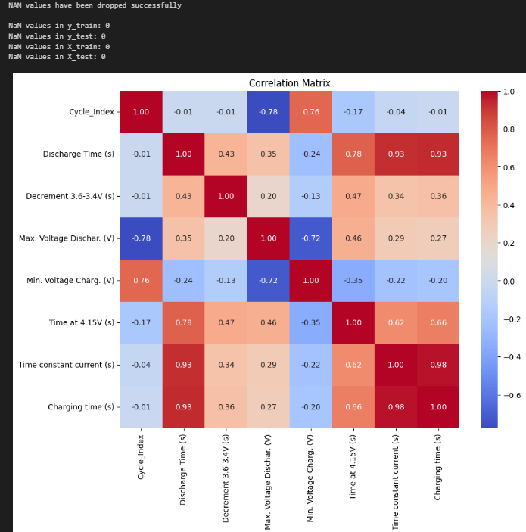
Random Forest Regression results:

Slide 42
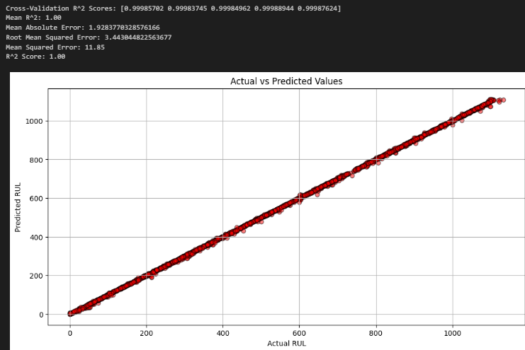
Random Forest Regression results:

Slide 43
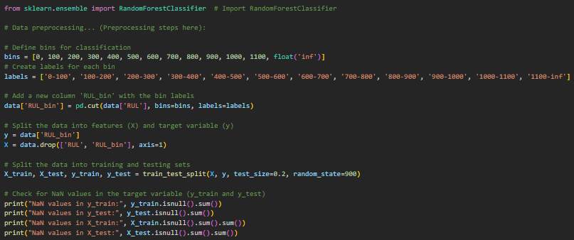
Random Forest Classification :
Random Forest Classification is a go-to choice for many practitioners due to its ability to improve accuracy and handle complex datasets. It is particularly useful when interpretability of individual trees is not a primary concern, and the focus is on achieving robust and accurate predictions.

Slide 44
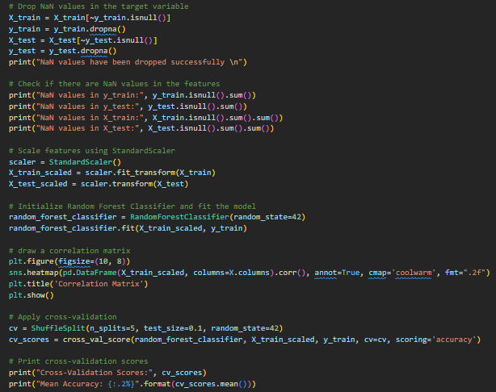
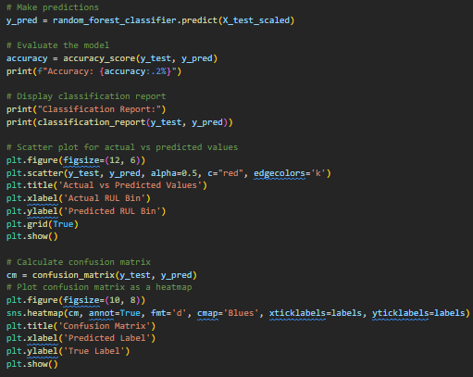
Random Forest Classification :

Slide 45
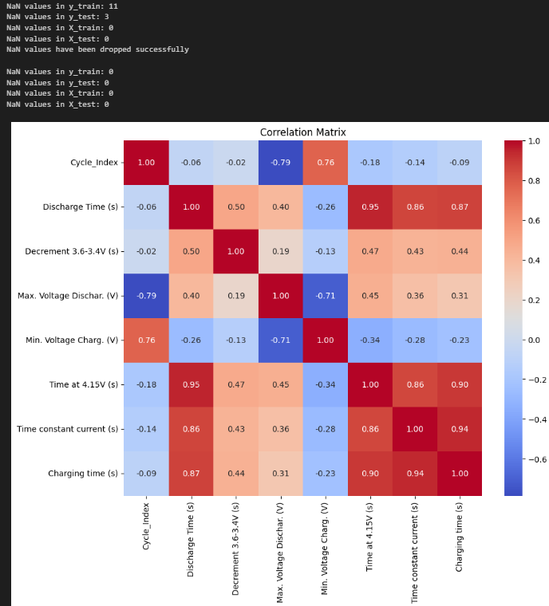
Random Forest Classification results:

Slide 46
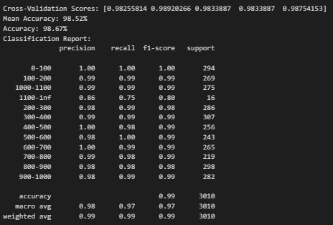
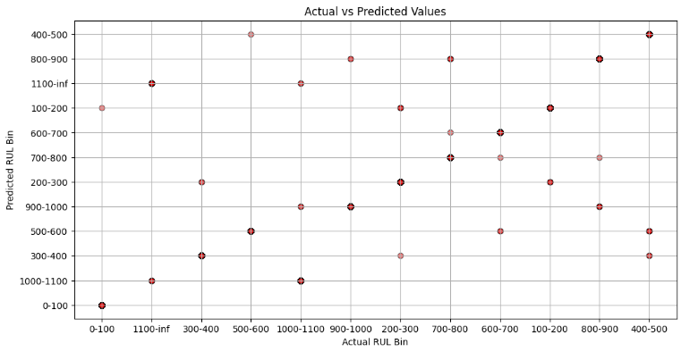
Random Forest Classification results:

Slide 47
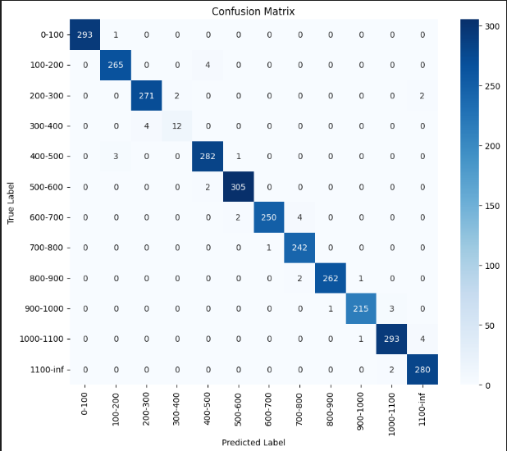
Random Forest Classification results:

Slide 48
Classificcation Accuracy Comparison :
KNN
01
02
Logistic Regression
97.51%
91.13%
Decision Tree
03
04
Support Vector
98.04%
91.89%
Random Forrest
05
98.67%

Slide 49

Thanks! ❤️
Do you have any questions? 🤔
Samer.wael.2003@gmail.com
+201554563448
Samer Wael

